Slide 1
Lecture 7
Signals and Systems (ELL205)
By Dr. Abhishek Dixit
Dept. of Electrical Engineering
IIT Delhi

Slide 2
Outline of the Lecture
System Properties
  Memoryless
  Causal
  Invertible
  Stable
  Time invariant
  Linear
  Incrementally Linear

Slide 3
Outline of the Lecture
System Properties
  Memoryless
  Causal
  Invertible
  Stable
  Time invariant
  Linear
  Incrementally Linear

Slide 4
Stable
A system is said to be stable if bounded inputs lead to bounded outputs.

Slide 5
Stable
A system is said to be stable if bounded inputs lead to bounded outputs.
Stability is BIBO stability

Slide 6
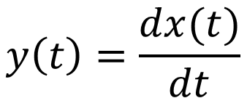
How many of them are stable systems?
A)
B)
C)
D)
$$y\left(t\right)=\frac{dx(t)}{dt}$$

Slide 7
How many of them are stable systems?
A)
B)
C)
D)
$$y\left(t\right)=\frac{dx(t)}{dt}$$

Slide 8
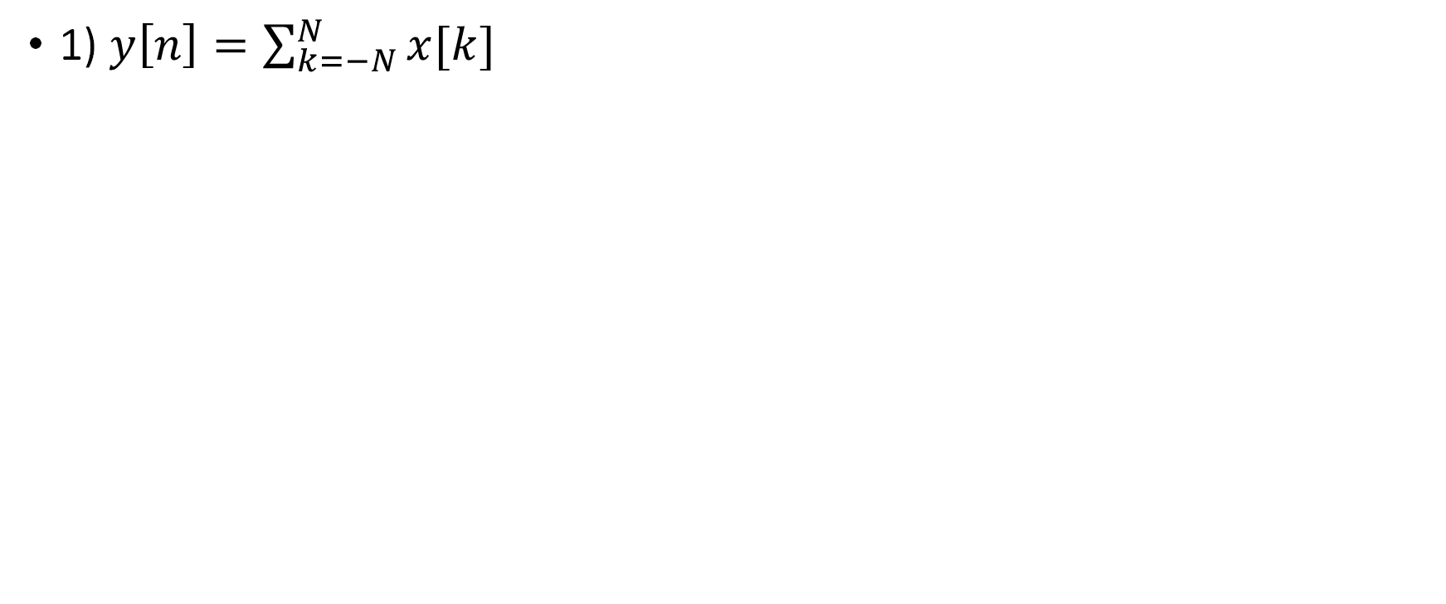
Checking stable systems
1) $y\left[n\right]=\sum_{k=−N}^{N}{x[k]}$

Slide 9
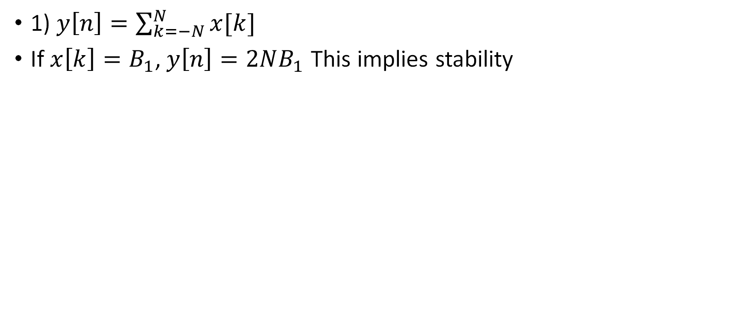
Checking stable systems
1) $y\left[n\right]=\sum_{k=−N}^{N}{x[k]}$
If $x\left[k\right]=B_{1}$, $y\left[n\right]=2NB_{1}$ This implies stability

Slide 10
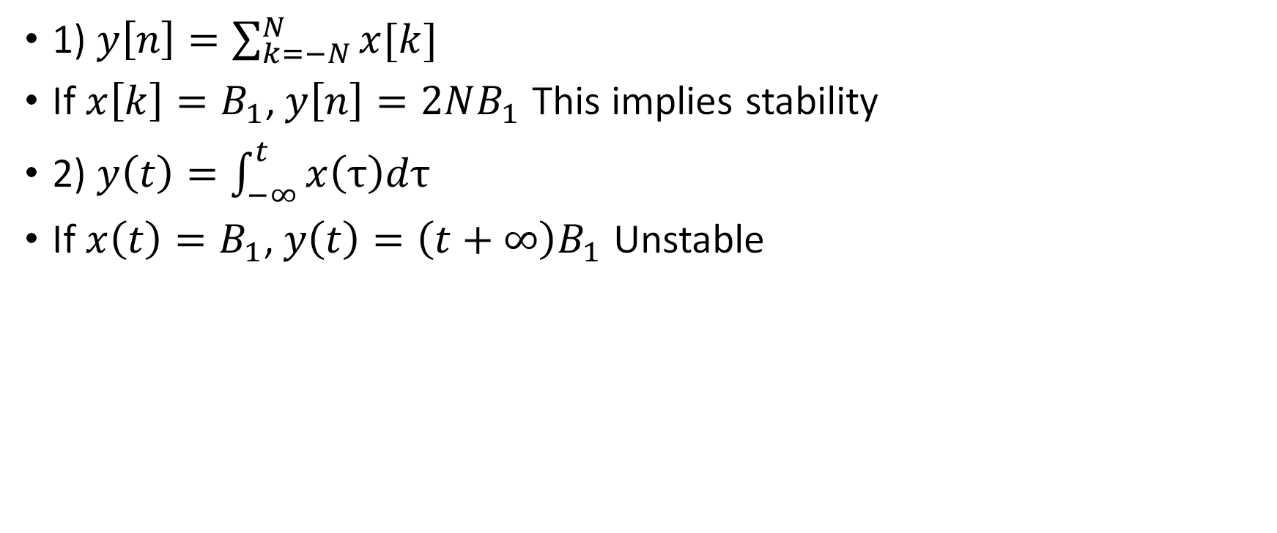
Checking stable systems
1) $y\left[n\right]=\sum_{k=−N}^{N}{x[k]}$
If $x\left[k\right]=B_{1}$, $y\left[n\right]=2NB_{1}$ This implies stability
2) $y\left(t\right)=\int_{−∞}^{t}{x\left(τ\right)dτ}$
If $x\left(t\right)=B_{1}$, $y\left(t\right)=\left(t+∞\right)B_{1}$ Unstable

Slide 11
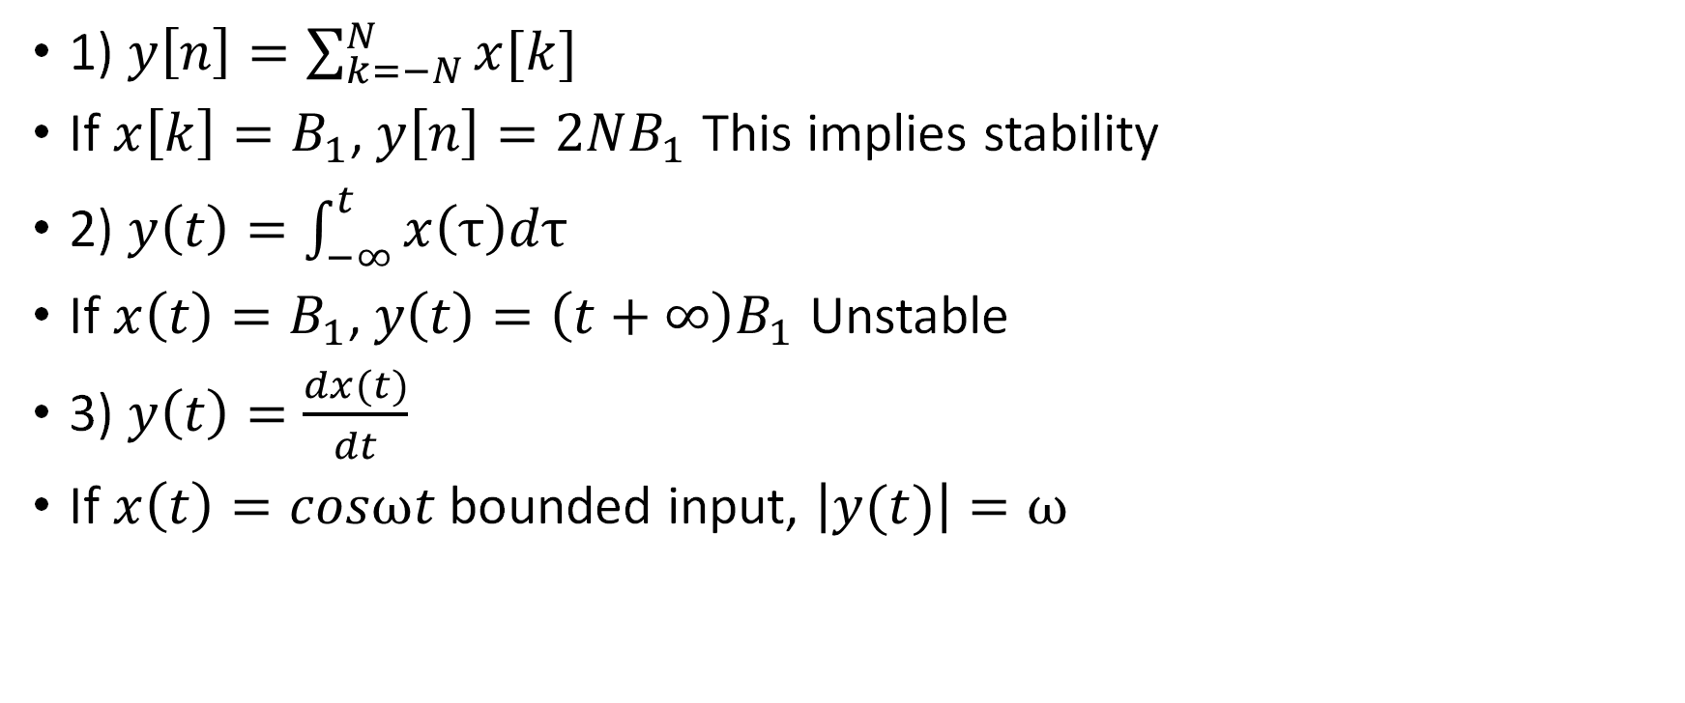
Checking stable systems
1) $y\left[n\right]=\sum_{k=−N}^{N}{x[k]}$
If $x\left[k\right]=B_{1}$, $y\left[n\right]=2NB_{1}$ This implies stability
2) $y\left(t\right)=\int_{−∞}^{t}{x\left(τ\right)dτ}$
If $x\left(t\right)=B_{1}$, $y\left(t\right)=\left(t+∞\right)B_{1}$ Unstable
3) $y\left(t\right)=\frac{dx(t)}{dt}$
If $x\left(t\right)=cosωt$ bounded input, $\left|y(t)\right|=ω$

Slide 12
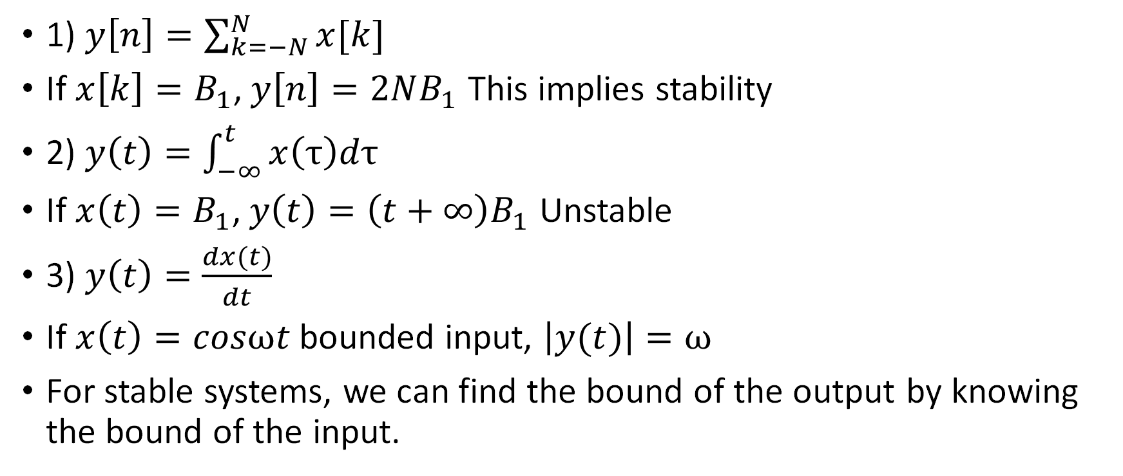
Checking stable systems
1) $y\left[n\right]=\sum_{k=−N}^{N}{x[k]}$
If $x\left[k\right]=B_{1}$, $y\left[n\right]=2NB_{1}$ This implies stability
2) $y\left(t\right)=\int_{−∞}^{t}{x\left(τ\right)dτ}$
If $x\left(t\right)=B_{1}$, $y\left(t\right)=\left(t+∞\right)B_{1}$ Unstable
3) $y\left(t\right)=\frac{dx(t)}{dt}$
If $x\left(t\right)=cosωt$ bounded input, $\left|y(t)\right|=ω$
For stable systems, we can find the bound of the output by knowing the bound of the input.

Slide 13
Stable
A system is said to be stable if bounded inputs lead to bounded outputs.
Stability is BIBO stability
Trick:
System is unstable if:
  Infinite summation
  Infinite integration
  Differentiators

Slide 14
Stable
A system is said to be stable if bounded inputs lead to bounded outputs.
Stability is BIBO stability
Trick:
System is unstable if:
  Infinite summation
  Infinite integration
  Differentiators
There are other forms of stability (for nonlinear systems): input-to-state, Lyapunov stability

Slide 15
Outline of the Lecture
System Properties
  Memoryless
  Causal
  Invertible
  Stable
  Time invariant
  Linear
  Incrementally Linear

Slide 16
Time-invariance
A system is said to be time-invariant if a time delay or time advance in the input produces an identical time shift in the output.

Slide 17




Time-invariance
A system is said to be time-invariant if a time delay or time advance in the input produces an identical time shift in the output.
TI system
$$x(t)$$
$$y\left(t\right)$$
TI system
$$x(t−to)$$
$$y\left(t−to\right)$$

Slide 18

How many of them are time-invariant systems?
$$y\left(t\right)=sin⁡(x\left(t\right))$$

Slide 19

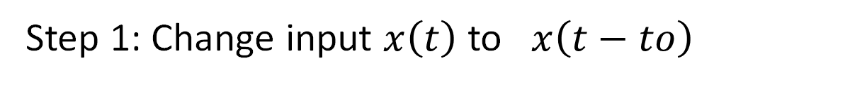
How many of them are time-invariant systems?
$$y\left(t\right)=sin⁡(x\left(t\right))$$
Step 1: Change input $x\left(t\right)$ to $x\left(t−to\right)$
$$sin⁡(x\left(t−to\right))$$
Equ. 1

Slide 20
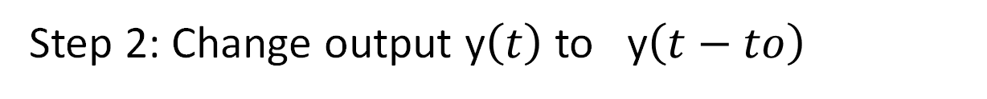

How many of them are time-invariant systems?
$$y\left(t\right)=sin⁡(x\left(t\right))$$
Step 1: Change input $x\left(t\right)$ to $x\left(t−to\right)$
$$sin⁡(x\left(t−to\right))$$
Equ. 1
Step 2: Change output y$\left(t\right)$ to y$\left(t−to\right)$
Equ. 2
$$y\left(t−to\right)=sin⁡(x\left(t−to\right))$$

Slide 21
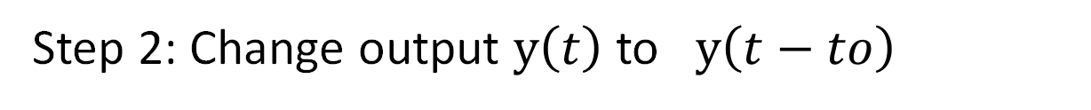
How many of them are time-invariant systems?
$$y\left(t\right)=sin⁡(x\left(t\right))$$
Step 1: Change input $x\left(t\right)$ to $x\left(t−to\right)$
$$sin⁡(x\left(t−to\right))$$
Equ. 1
Step 2: Change output $y\left(t\right)$ to $y\left(t−to\right)$
Equ. 2
$$y\left(t−to\right)=sin⁡(x\left(t−to\right))$$
Step 3: TI if Equ. 1 and Equ. 2 matches

Slide 22

How many of them are time-invariant systems?
A)
B)
C)
D)
$$y\left(t\right)=sin2⁡(x\left(t\right))$$

Slide 24
How many of them are time-invariant systems?
A)
B)
C)
D)
$$y\left(t\right)=sin2⁡(x\left(t\right))$$

Slide 25




How many of them are time-invariant systems?
A)
B)
C)
D)
$$y\left(t\right)=x2(t)$$
$$y\left[n\right]=Ev\{x\left[n\right]\}$$
$$y\left(t\right)=x2(t/2)$$
$$y\left(t\right)=tsin⁡(x\left(t\right))$$

Slide 26
How many of them are time-invariant systems?
A)
B)
C)
D)
$$y\left(t\right)=x2(t)$$
$$y\left[n\right]=Ev\{x\left[n\right]\}$$
$$y\left(t\right)=x2(t/2)$$
$$y\left(t\right)=tsin⁡(x\left(t\right))$$

Slide 27
Outline of the Lecture
System Properties
  Memoryless
  Causal
  Invertible
  Stable
  Time invariant
  Linear
  Incrementally Linear

Slide 28
Linearity
A system is said to be linear iff it satisfies superposition (additivity & homogeneity)

Slide 29








Linearity
A system is said to be linear iff it satisfies superposition (additivity & homogeneity)
Additivity
$$x1(t)$$
$$y1\left(t\right)$$
$$x2(t)$$
$$y2\left(t\right)$$
$$x1(t)$$
$$+ x2(t)$$
$$y1\left(t\right)$$
$$+ y2\left(t\right)$$

Slide 30


Linearity
A system is said to be linear iff it satisfies superposition (additivity & homogeneity)
Homogeneity
$$x1(t)$$
$$y1\left(t\right)$$
$$ax1(t)$$
$$ay1\left(t\right)$$

Slide 31

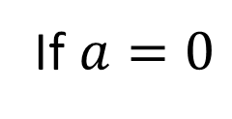

Linearity
A system is said to be linear iff it satisfies superposition (additivity & homogeneity)
Homogeneity
$$x1(t)$$
$$y1\left(t\right)$$
$$ax1(t)$$
$$ay1\left(t\right)$$
If $a=0$
$$0$$
$$0$$
ZIZO

Slide 32
Linearity
Does additivity not always implies homogeneity?

Slide 33
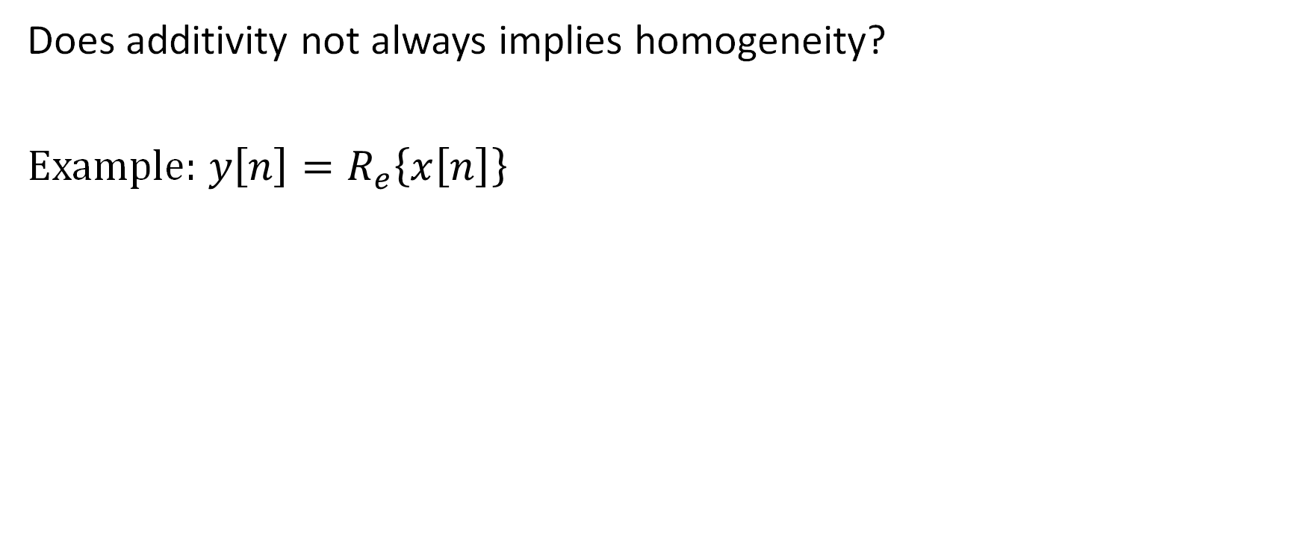
Linearity
Does additivity not always implies homogeneity?
Example: $y\left[n\right]=R_{e}\left\{x\left[n\right]\right\}$

Slide 34
Linearity
Does homogeneity not always implies additivity ?

Slide 35
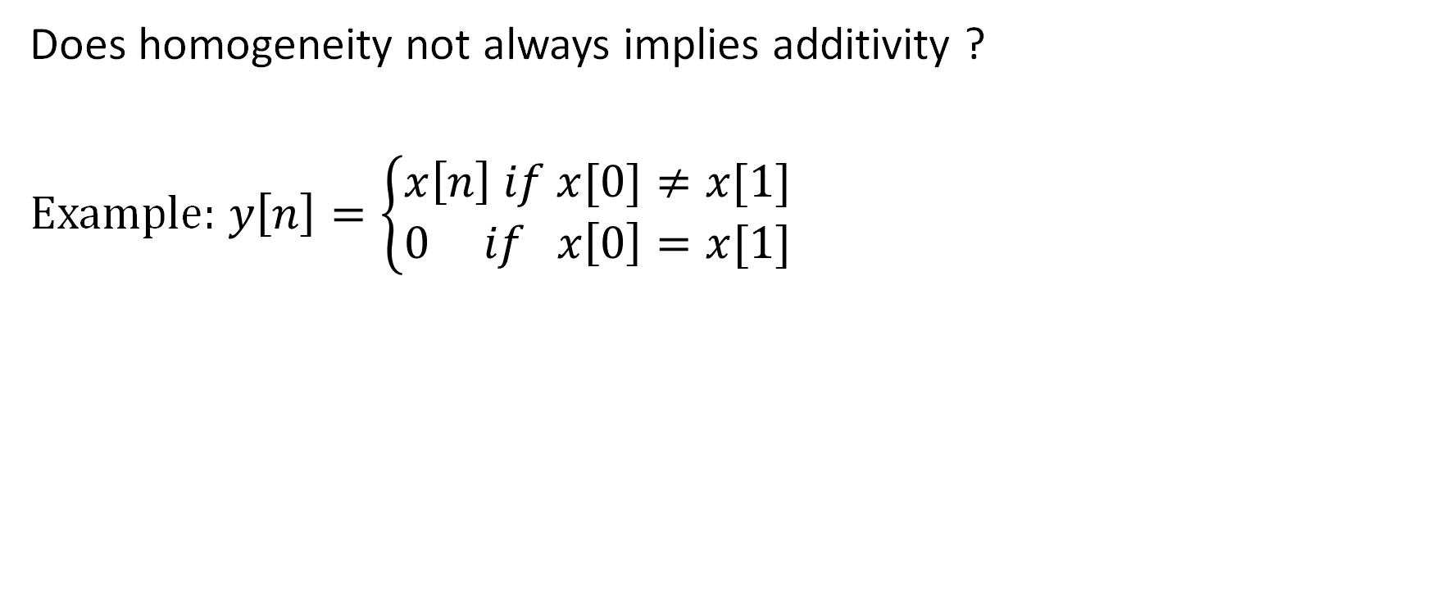
Linearity
Does homogeneity not always implies additivity ?
Example: $y\left[n\right]=\left\{\begin{aligned}x\left[n\right] if x[0]≠x[1] \\ 0 if x\left[0\right]=x[1]\end{aligned}\right.$

Slide 36



How many of them are linear systems?
A)
B)
C)
D)
$$y\left(t\right)=x2(t)$$
$$y\left[n\right]=Ev\{x\left[n\right]\}$$
$$y\left[n\right]=x\left[n\right]+5$$
$$y\left(t\right)=sin⁡(x\left(t\right))$$

Slide 38
How many of them are linear systems?
A)
B)
C)
D)
$$y\left(t\right)=x2(t)$$
$$y\left[n\right]=Ev\{x\left[n\right]\}$$
$$y\left[n\right]=x\left[n\right]+5$$
$$y\left(t\right)=sin⁡(x\left(t\right))$$

Slide 40
Outline of the Lecture
System Properties
  Memoryless
  Causal
  Invertible
  Stable
  Time invariant
  Linear
  Incrementally Linear

Slide 41
Incrementally Linear
An incrementally Linear system is
Linear + ZIR

Slide 42




Incrementally Linear
An incrementally Linear system is
Linear + ZIR
$$y\left[n\right]=2x\left[n\right]+5$$
$$5$$
2
$$x\left[n\right]$$
$$y\left[n\right]$$
Linear + ZIR

